Slide 1
Sparrow
The Dashcam Defender
sddec20-11
Evan Timmons, Cobi Mom, Danny Yip, Scott Vlasic, Durga Darba, Ismael Duran
Project Advisor: Joseph Zambreno
Team Leader Contact: timmonse@iastate.edu

Slide 2
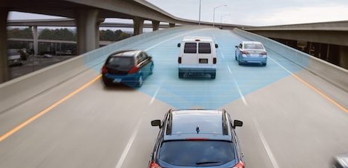
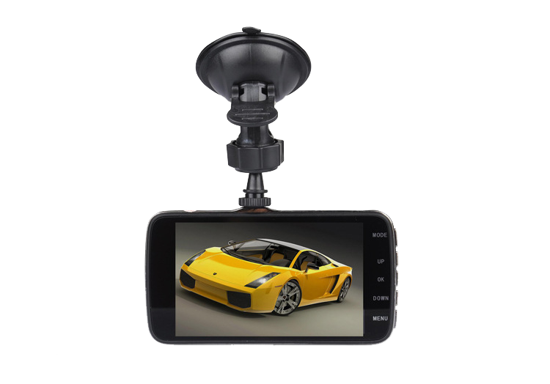
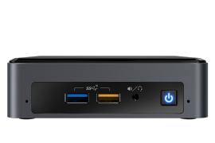
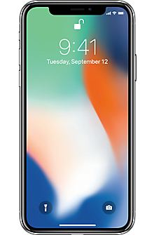
Overview
Fully featured plate recognition system
Hazard alerts
Poor driving reports etc
Three Main Components
ALPR Board
Mobile Application
Database
Evan Timmons

Slide 3
Overview
Android/iOS app built on Flutter
NVIDIA Jetson TX-2
GUI built on PySimpleGUI
AWS Pipeline
API Gateway
Lambda
DynamoDB
S3
Cobi Mom

Slide 4
Diagram
App Requests
App Requests
Cloud Upload
Cloud Download
Dash Camera
Mini PC
Phone Application
Record Video
Record Request
Footage Review
Local License Plate Lookup
Cloud License Plate Lookup
All other requests
Save Raw Backup
System Control
Return Request
Stream
Analyze Video
Perform ML Lookup
Annotate File
ML System
Save Backup
Save Annotated Backup
Save Backup
Evan Timmons

Slide 5
Functional Requirements
Capture and analyze video
Lookup video by license plate
Mobile application for user to access the software system
Ismael Duran
Notes:
Capture Video
Analyze video data
Browse video by license plate
Mobile platform

Slide 6
Non-Functional Requirements | Operating Environment
Mounted within vehicle
Must handle temperature fluctuations and changing road conditions
Reliably record 1080p video quality
Maintain 60 frames per second
Mobile app responds in under 1 second
Scott Vlasic

Slide 7
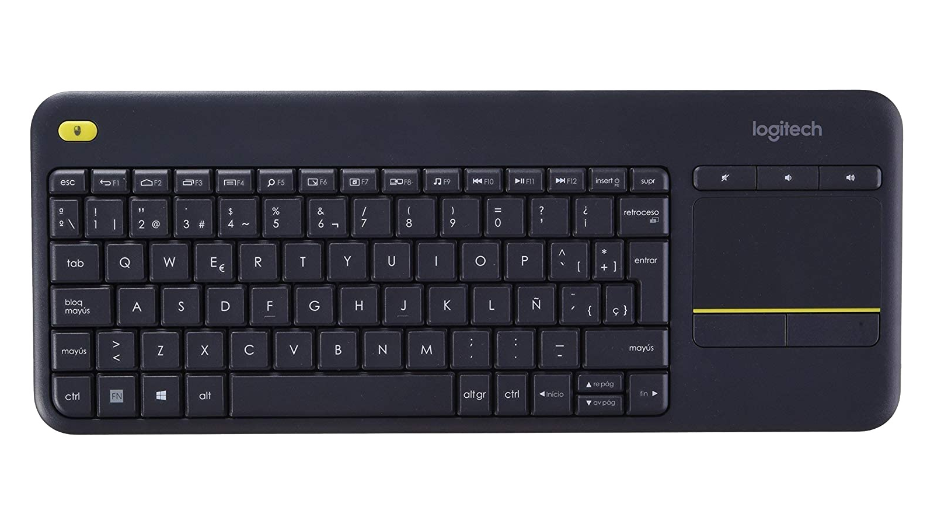
ALPR Board
NVIDIA Jetson TX-2
1080p Webcam
Mini HD Display (7 inch)
Logitech Keyboard/Mouse Combo
Graphical User Interface
Scott Vlasic

Slide 8
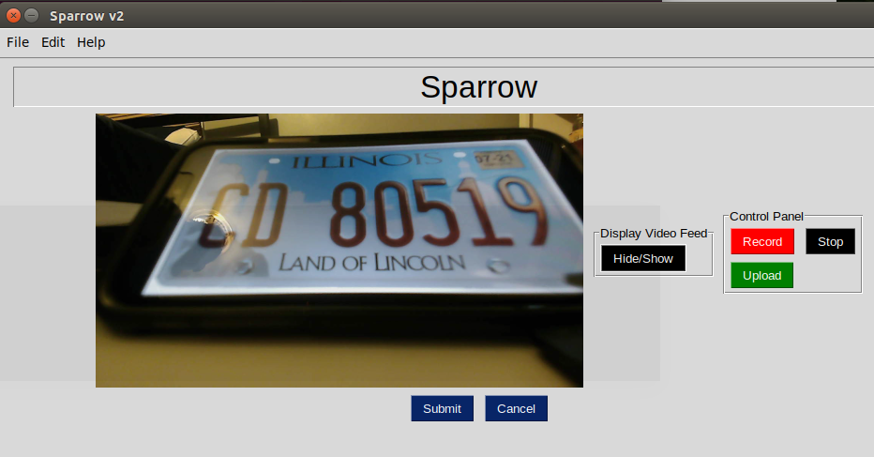
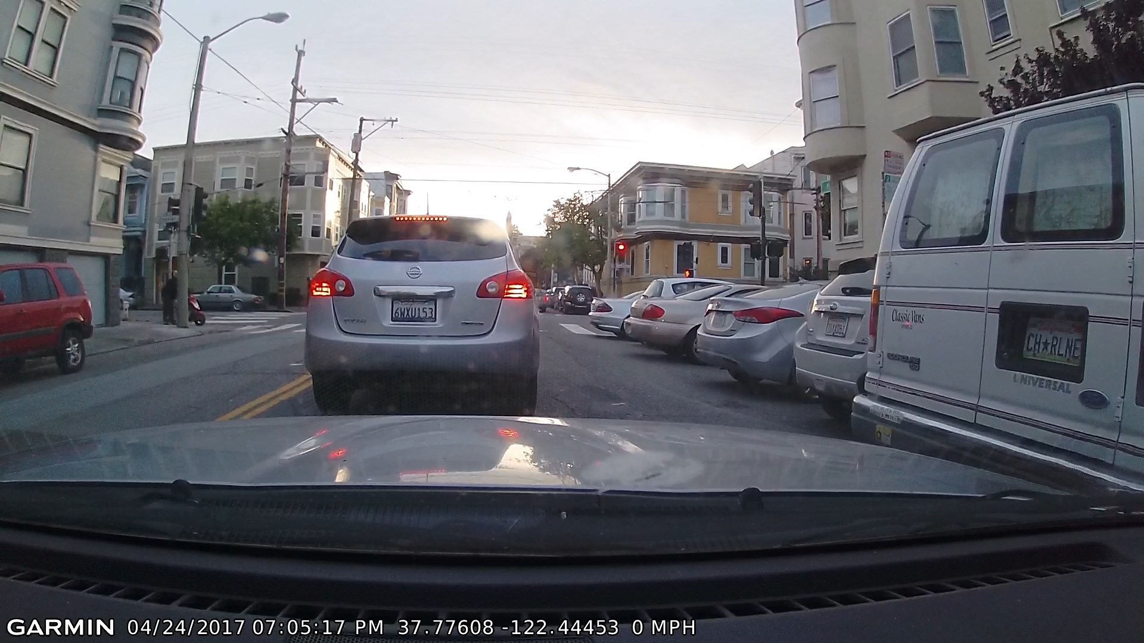
ALPR Board GUI
Python Script
PySimpleGUI, OpenCV, tKinter, etc.
Record footage and run ALPR analysis
Upload Footage
AVI and JSON Files
Custom Bash Scripts
newVCam
v4l2loopback to create virtual cam
videoSplit2
Uses ffmpeg to stream virtual output
recordWebcam
called by Python Script to record
Evan Timmons

Slide 9
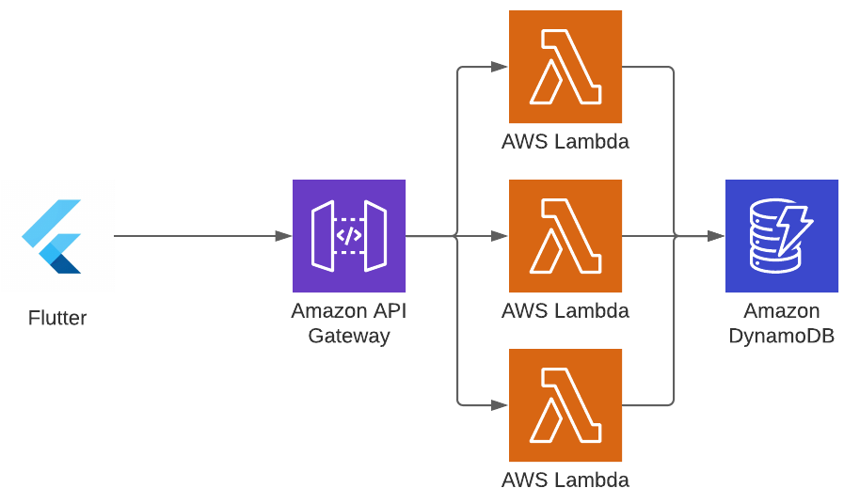
Amazon Web Services
API Gateway
For handling HTTP Requests
Lambda
Multiple functions for serverless functionality
DynamoDB
Stores user/car/license plate data
Cobi Mom

Slide 10
Amazon Web Services
S3
Used as an arbitrary datastore for videos
Integrated with Dynamo such that file paths to videos are stored
Jetson sends video to S3
boto3
Then sends post call to API gateway
requests
Durga Darba

Slide 11
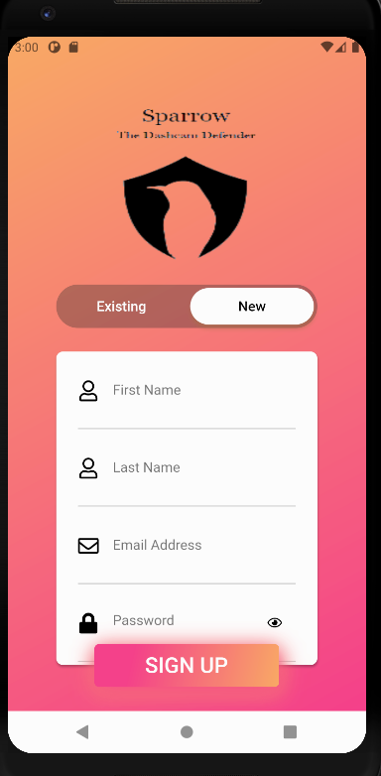
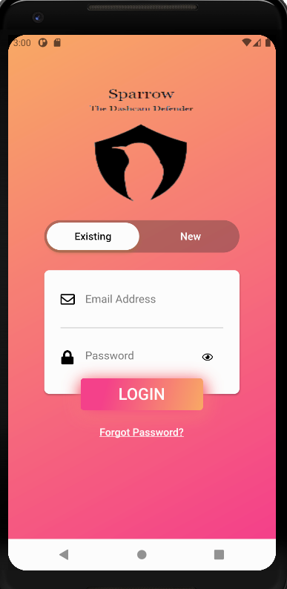
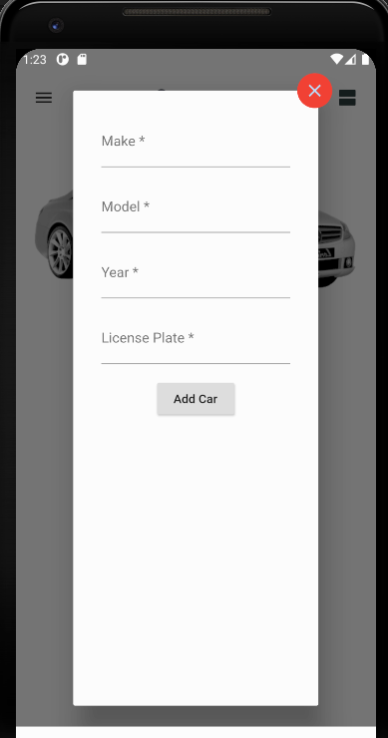
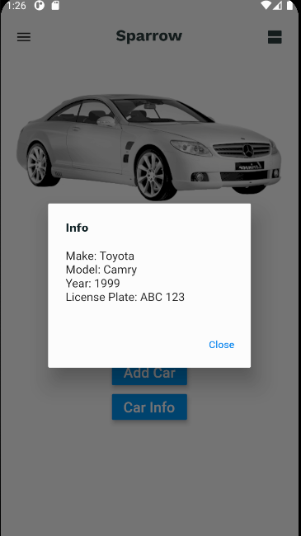
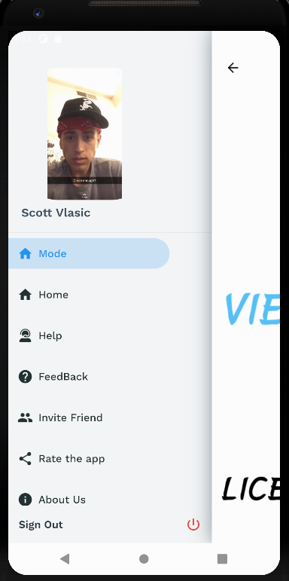
Mobile Application One
(1) (2) (3) (4) (5) (6)
Danny Yip

Slide 12
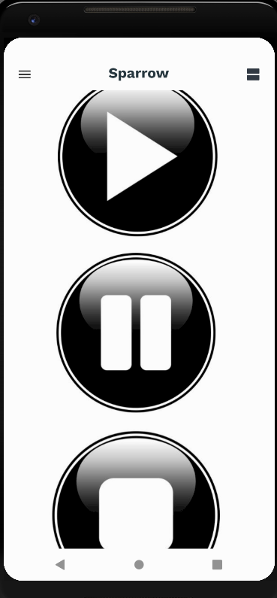
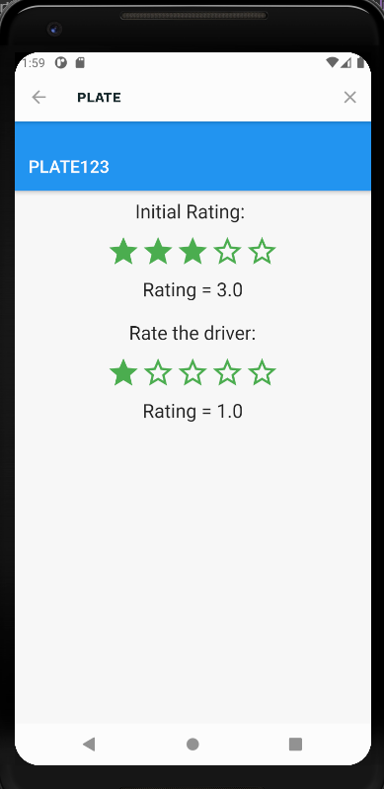
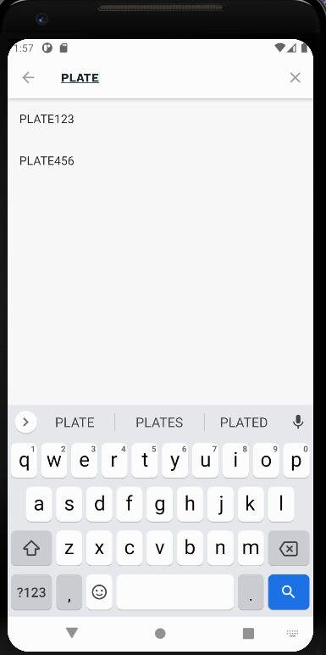
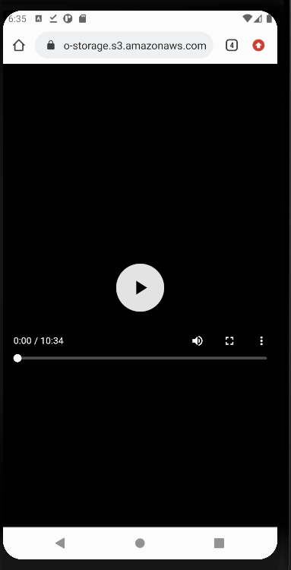
Mobile Application Two
(1) (2) (3) (4) (5) (6)
Danny Yip

Slide 13
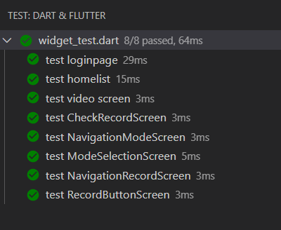
Mobile Application Testing
Utilize flutter_test.dart
Ability to Run and Debug quickly
8 thorough tests
Tests are manually triggered
More tests can be implemented in the future
Danny Yip

Slide 14
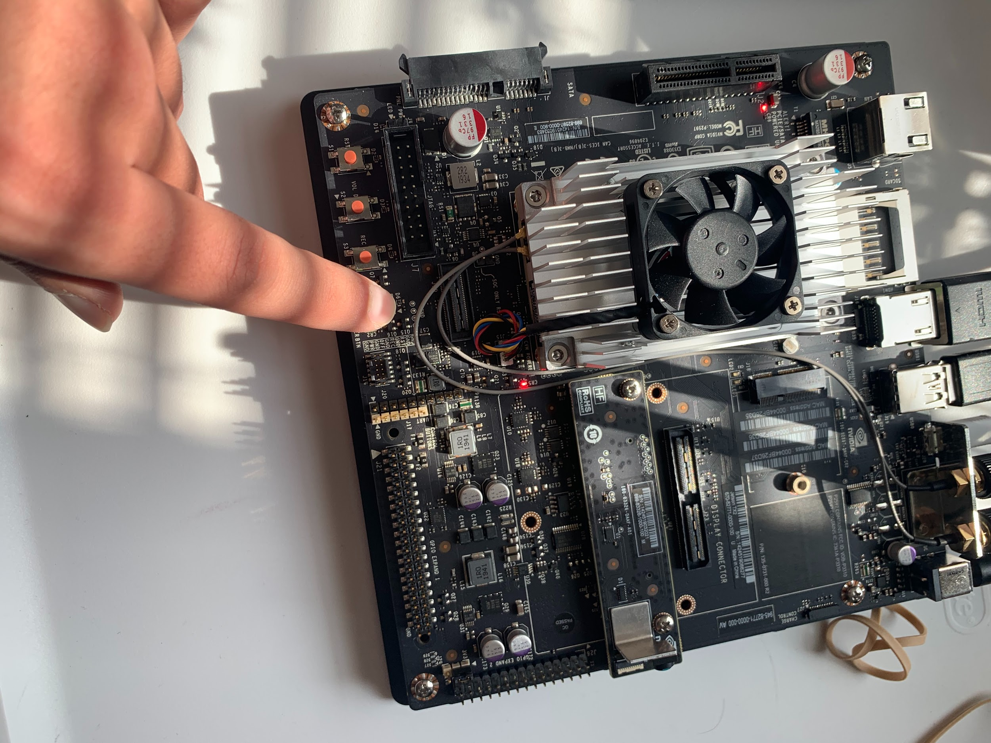
ALPR Board Testing
Road Test
Test without WiFi
Temporarily stores video
Functional test
Maintains 60fps at 1080p
Tried to find upper and lower frame rate and resolution bounds
Database Load Test
Durga Darba
Notes:
Mention frame rate @ 1080p. Mention we want to make this better over time.

Slide 15
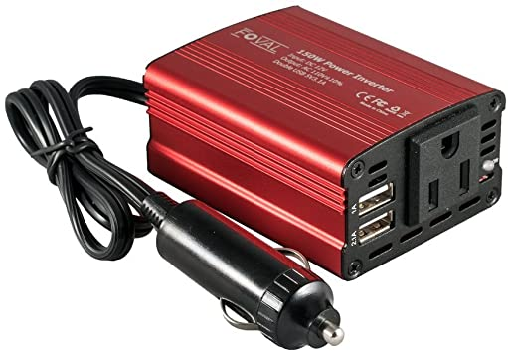
Issues Faced
Loss of access to NVIDIA Jetson
Resolved by reflashing OS
OpenALPR Camera Detection
Communication from NVIDIA Jetson to Amazon S3 Bucket
Power Supplementation in Operating Environment
Scott Vlasic

Slide 16
Issues Continued: Server to Serverless
Simple to set up
Team experience with cloud development
Flexible, reliable, and scalable
Trouble with server configuration
Team unfamiliar with technology
Ismael Duran

Slide 17
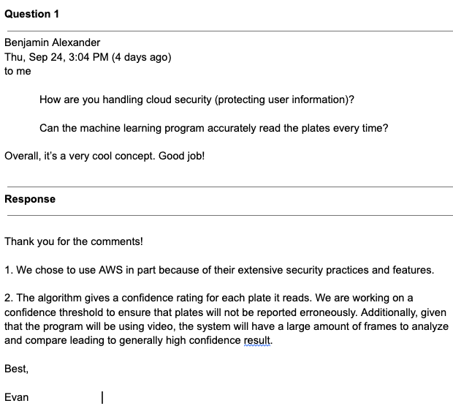
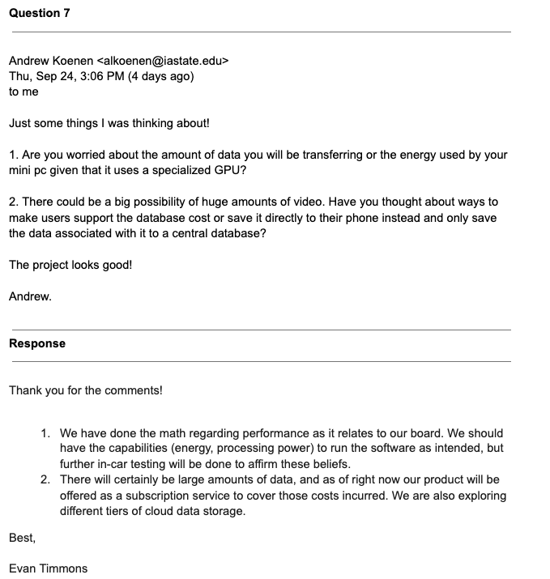
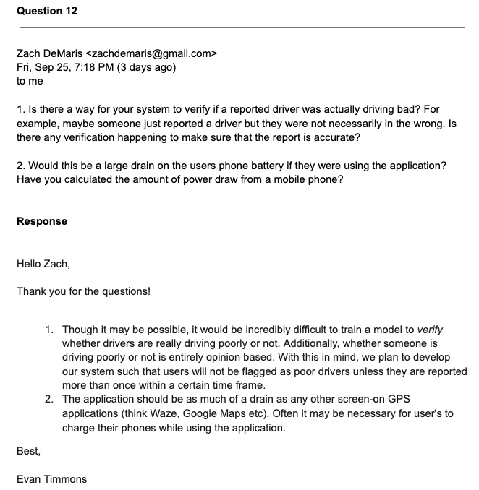
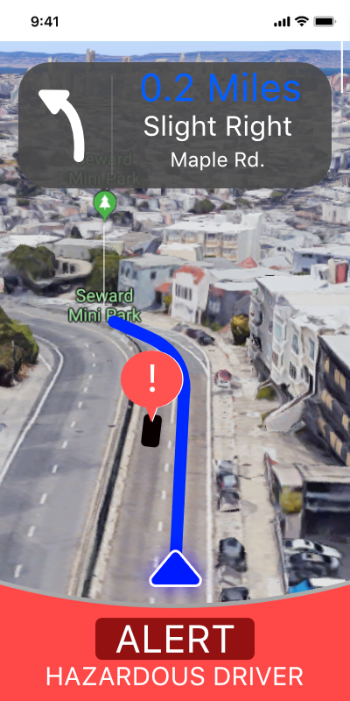
Project Feedback
Twenty five messages of feedback
Largely positive responses
Main critical remarks
Privacy
Restricted API etc
Safety
Waze style interaction
Evan Timmons

Slide 18
Alternative Approaches
Web App
AngularJS
Server/Database
Python Flask
PostgreSQL
Cobi Mom

Slide 19
Cloud Computing
Leverage cloud service to run ALPR remotely
Reduce hardware equipment needed
Decreased upfront cost for the user
More opportunity to work remotely
No upper bound on the performance
Ismael Duran

Slide 20
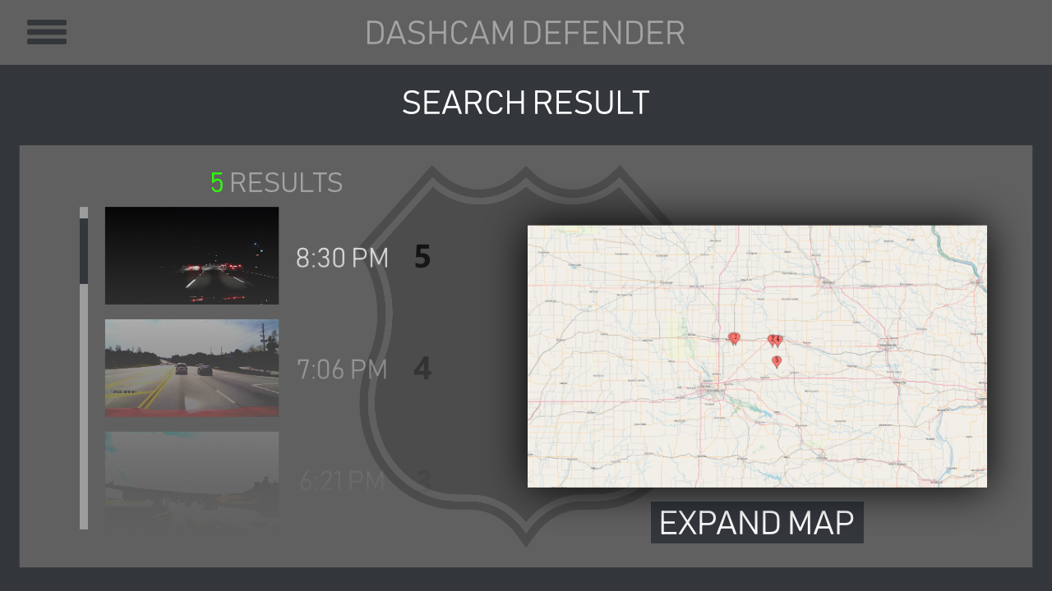
Context - Moving Forward
Building enclosure
Remove unnecessary Jetson components
Law Enforcement API System
Integration with Amber Alert
Insurance API System
Help with fraudulent claims
Durga Darba

